Slide 1
KS2 SATS 2022

Slide 2
What are they?
Standard Assessment Tests
English Reading
English Grammar & Punctuation
Spelling
Maths – Reasoning & Arithmetic
By using teacher assessment, schools and the government are able to judge a child’s performance in a subject over a longer period of time.

Slide 3
What are they for?
Predominantly used for both parents and teachers to learn more about their child’s academic strengths and weaknesses.
Give teachers the chance to see how children are doing in comparison to their peers not only within the same school, but also nationally.
Useful tool to see how well a child has progressed from KS1 to KS2.
Give secondary schools a base to compare against when the time comes for your child to leave Year 6 and make the journey up to KS3!
Headteachers, Local Authorities and the Department for Education also uses SATs data to identify which primary schools are excelling, and which may be struggling.

Slide 4
Are they important?
Are SATs for the school or child?
No direct consequences of a fail – no retakes.
Prospective employers wont be worried about a ‘below expected standard’ SATs result.
Opportunities

Slide 5
Why do them?
Chance to shine!
Mandatory
Testing is a part of our culture.
Can be good measure of progress & can identify areas which may need a boost
SATs are often used by secondary school to set for maths and English

Slide 6
How are we preparing?
Practising previous SATS papers
Continuous Assessment
Booster Classes & homework club
Focused Maths Lessons
Focused Spelling Lessons
Focused SPaG Lessons
Guided and Independent Reading
Home Learning
Target Setting and Mentoring

Slide 7
WHEN ARE THE TESTS?
Date
Monday 9th May | English grammar, punctuation and spelling Paper 1: questions Paper 2: spelling
Tuesday 10th May | English reading
Wednesday 11th May | Mathematics Paper 1: arithmetic Paper 2: reasoning
Thursday 12th May | Mathematics Paper 3: reasoning

Slide 8
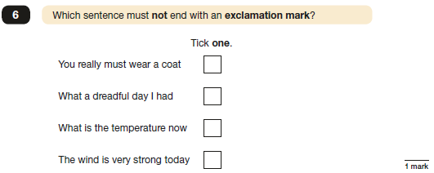
What are they like?
KS2 reading SATs:
One paper - questions based on 3 texts. 1 hour.
Grammar, punctuation and spelling SATs: Range of question types: multiple choice, true or false and written answers. 45 minutes.
20-word aural spelling test lasts around 15 minutes.

Slide 9
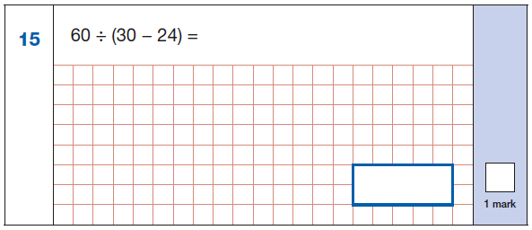
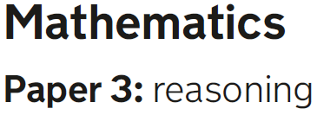
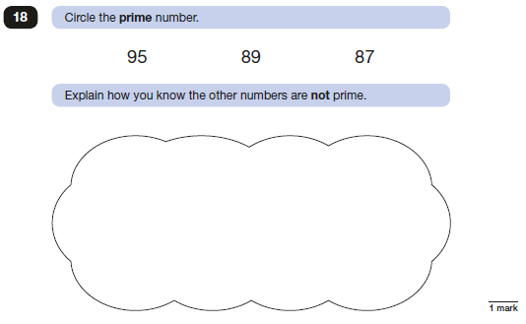
What are they like?
KS2 Maths SATs:
Paper 1 - arithmetic paper, 30 minutes. Fixed response questions.
Papers 2 and 3 - wider range of question types: multiple choice, true or false and reasoning based. Both 40 minutes

Slide 10
REPORTING RESULTS
Children’s achievement will be measured and reported on in school performance tables.
Teacher assessments will be passed on to secondary schools, however we also have in depth transition meetings and overall teacher assessments are shared.
The papers are returned in early July.
Written reports are given at the end of the summer term along with your child’s results.

Slide 11
REPORTING RESULTS 2
Instead of receiving levels as happened in previous years, each pupil sitting the tests will receive:
A raw score – the total number of marks scored in the test
A scaled score – based on the raw score converted after the test.
100 = threshold/met the standard expected
Confirmation of whether or not they have attained the national standard

Slide 12
Understanding the Score
Top scaled score of 120
Lowest scaled score of 80.
Scaled score of 100 or more met the expected standard
Scaled score of 99 or below not met the expected standard.
120
110
The Expected Standard
100
90
80

Slide 13
HELPING AT HOME
Try not to put pressure on your child.
Support with homework and targets that have been discussed at Parents’ Evening.
Read regularly and discuss a variety of texts – not just ‘listening’ to your child read.
Short bursts of mental maths, times tables and problem solving etc.
Use the previous test papers only if advised by teachers, as they are used in school as assessment and practise for the children. Using the same papers at home makes it difficult for us to prepare the children adequately.

Slide 14
WE RECOMMEND:-
Early nights and lots of sleep
Good attendance
Good punctuality
A good breakfast
LOTS OF PRAISE AND ENCOURAGEMENT!

Slide 15
USEFUL WEBSITES
https://www.bbc.co.uk/bitesize
http://www.bbc.co.uk/education
These are excellent sites, recently updated to provide revision help for KS2, KS3, KS 4 and KS5. This covers all subjects through activities and tests.
http://www.educationquizzes.com/ks2/maths/
A site with both Maths and English based quizzes which are marked as you go along.
http://www.icteachers.co.uk/children/children_sats.htm
A wide range of KS2 SATs questions, from both past papers and their own team of teachers.
http://primaryhomeworkhelp.co.uk/
Revision pages from the former site of Woodlands Junior School. These revision pages were put together by staff at Woodlands Junior School. The site provides links to many useful games to help with revision.
Times Table Rockstars
Times Tables Revision for fluency
Apps/Games on tablets
Just search SATs/educational games

Slide 16
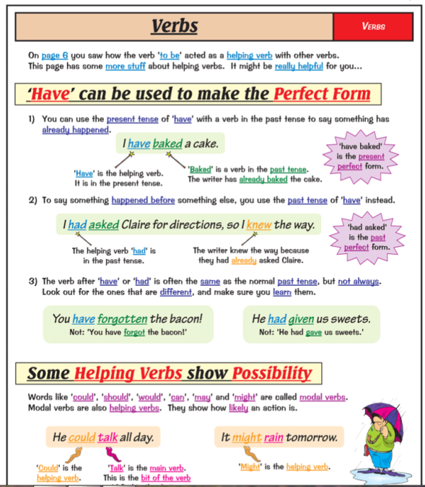
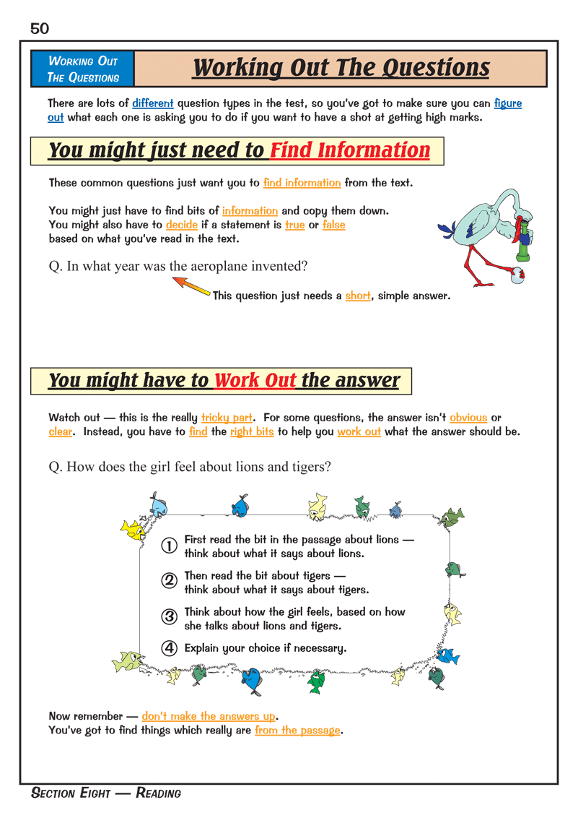
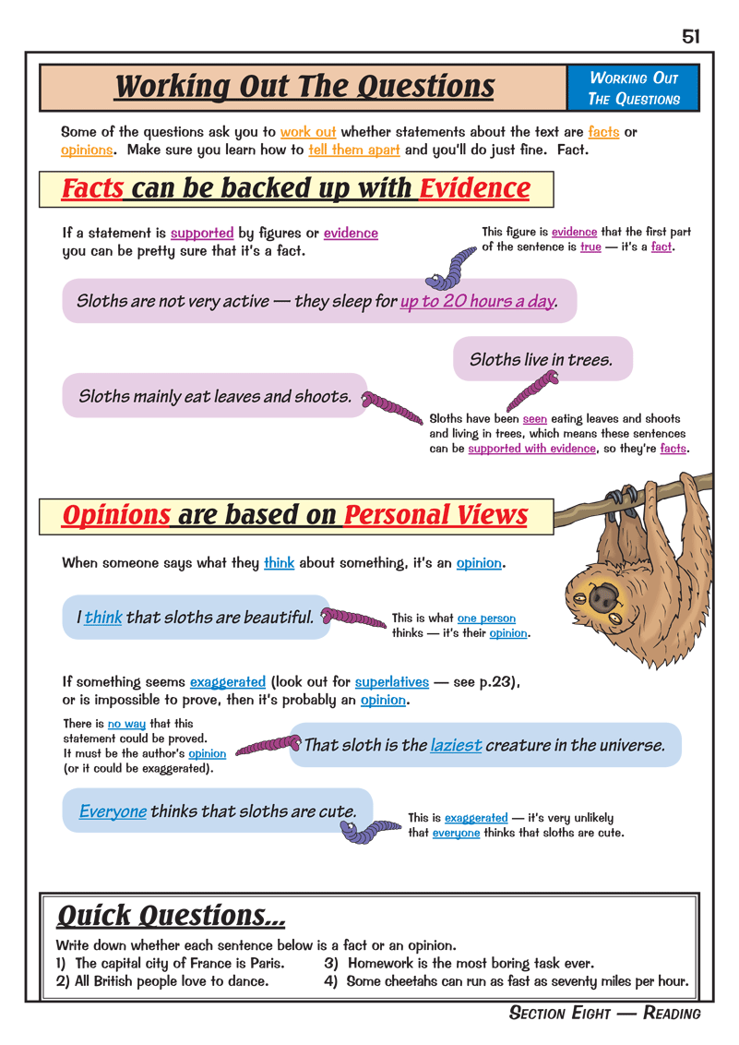
E English Revision Book

Slide 17
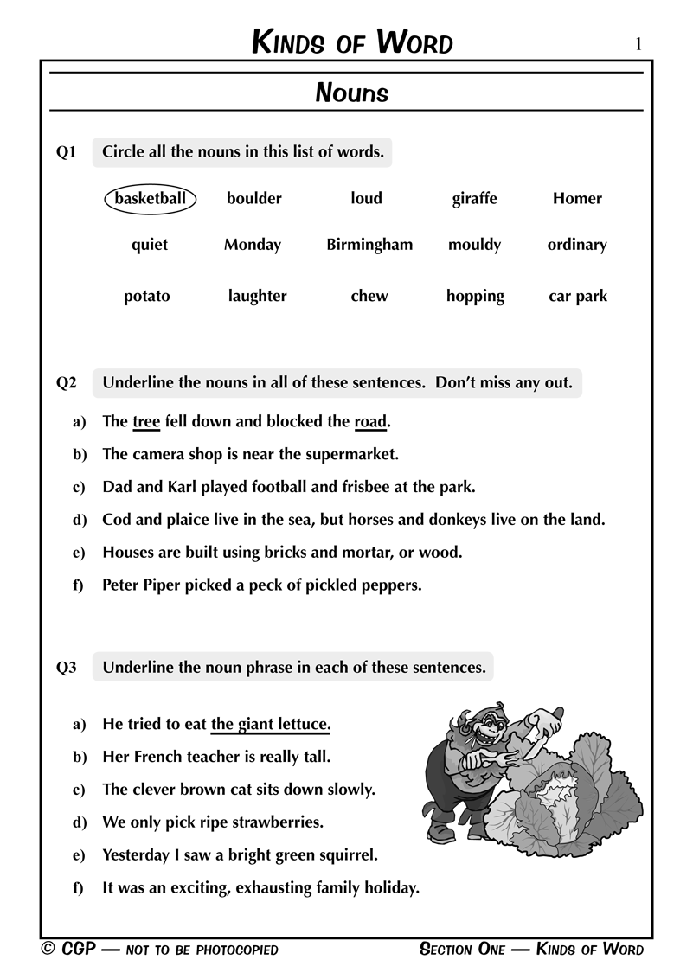
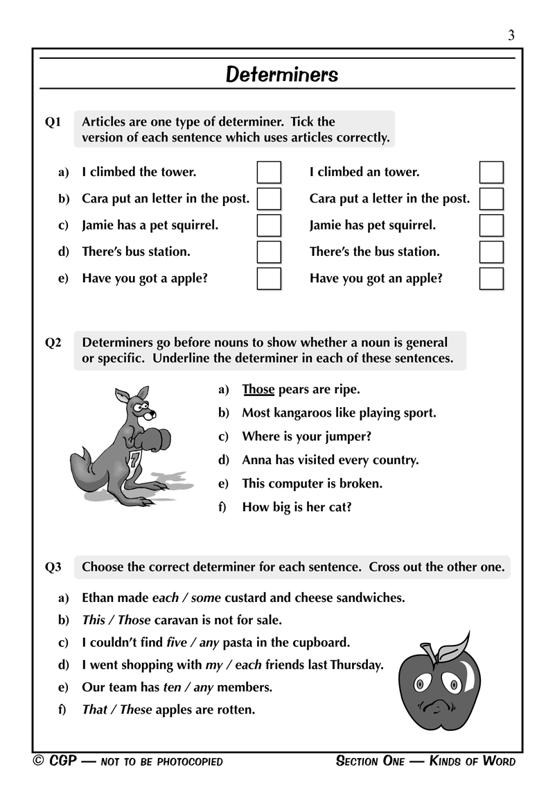
English Question Book

Slide 18
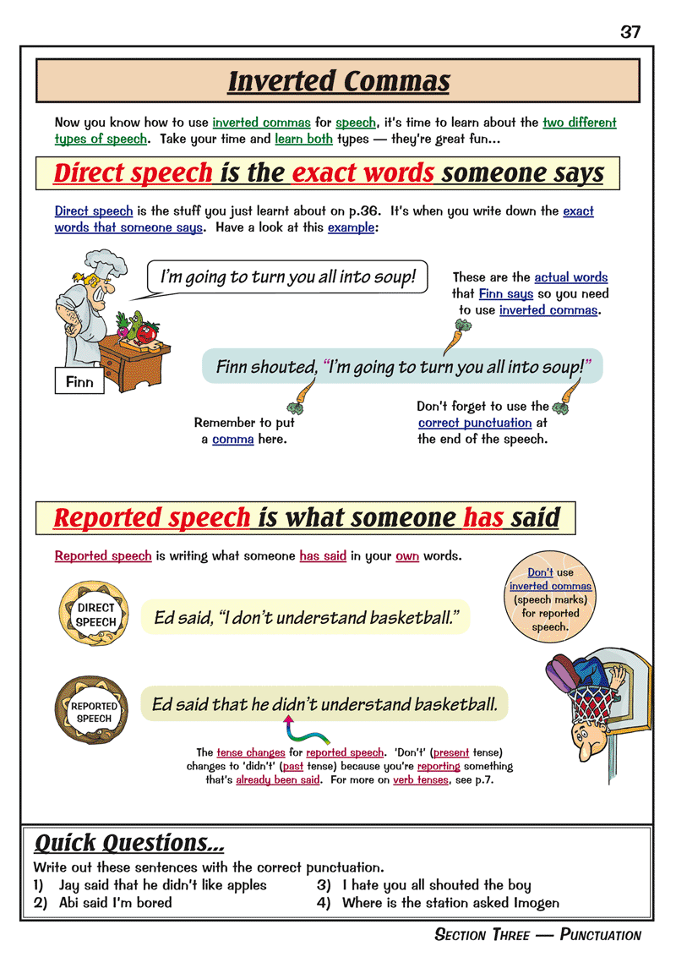
Grammar, Punctuation & Spelling Book

Slide 19
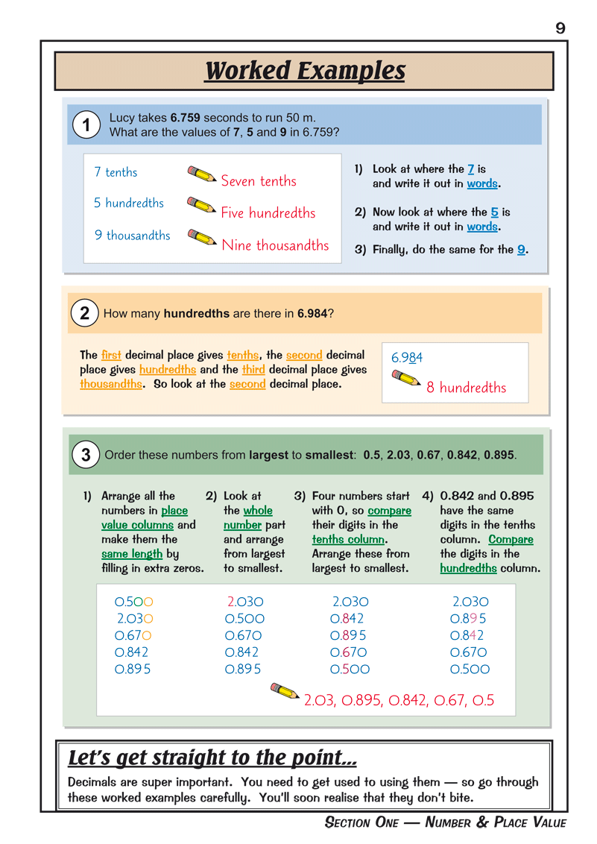
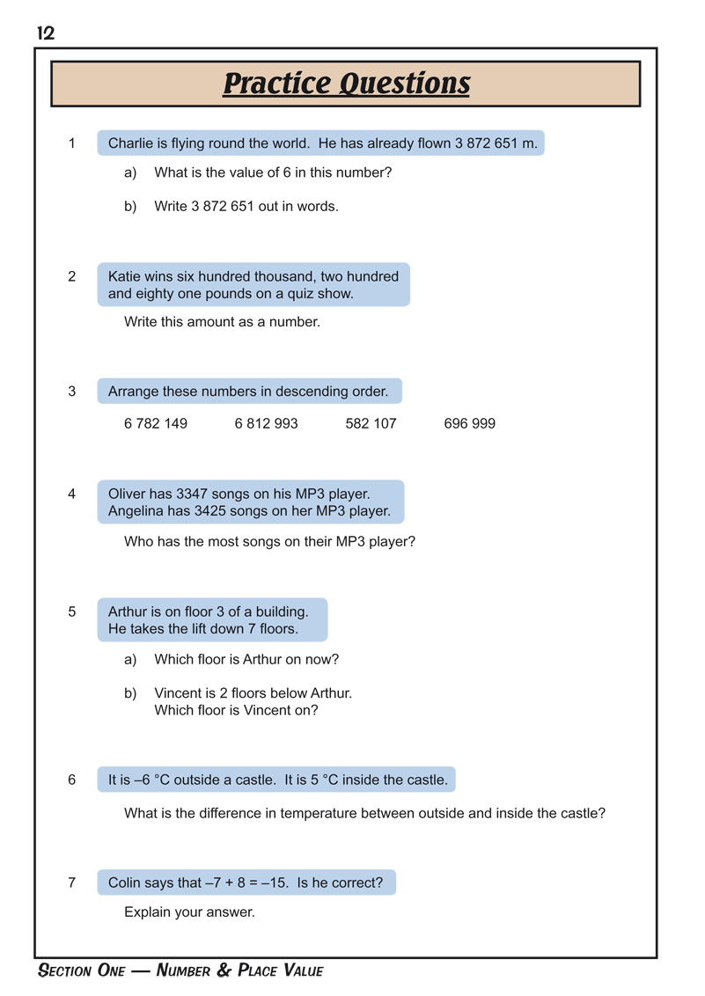
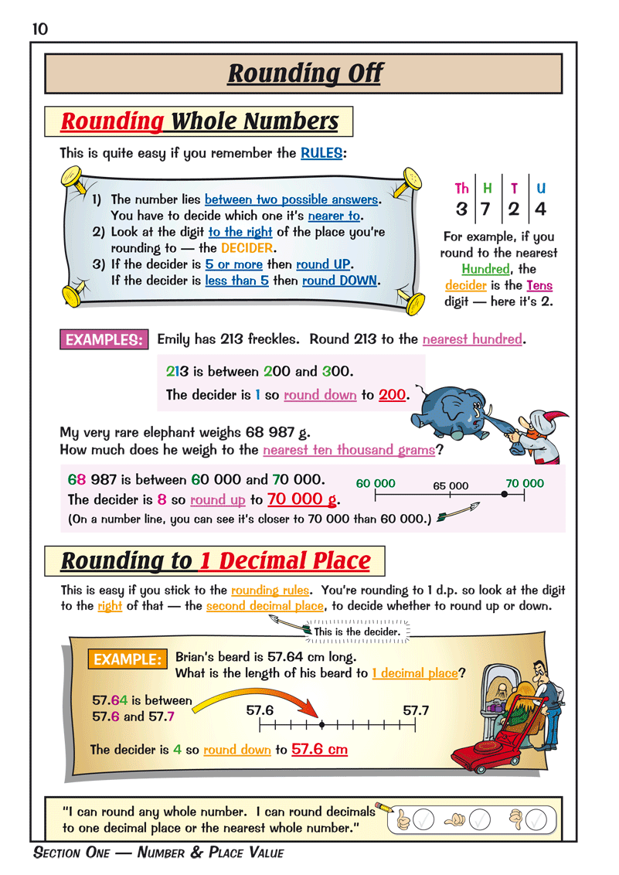
Maths Revision Books

Slide 20
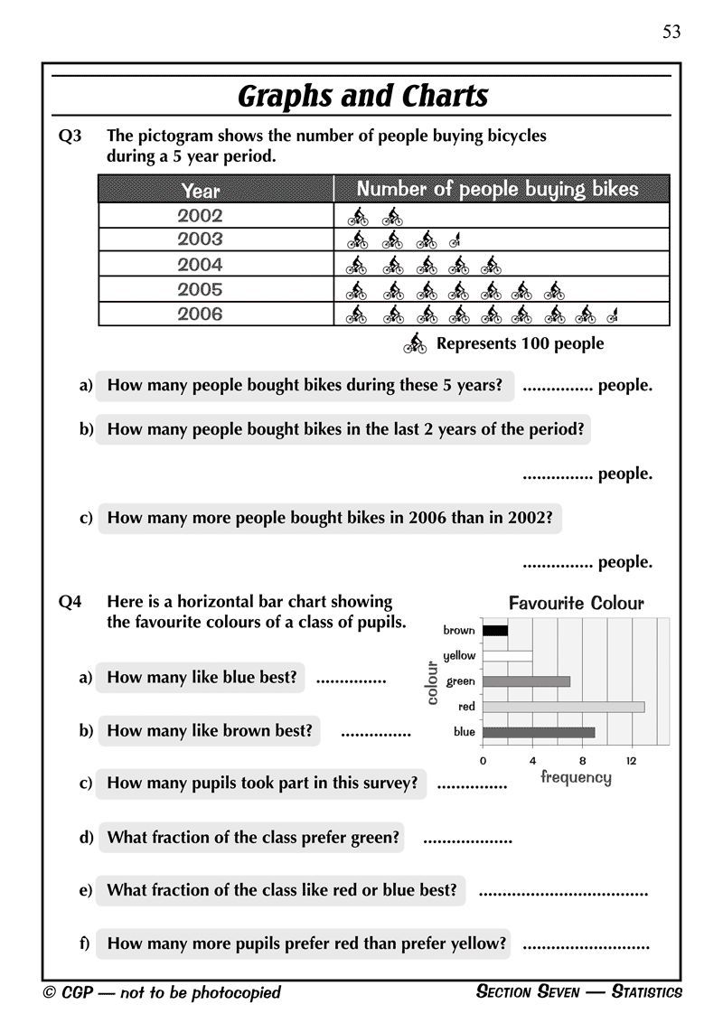
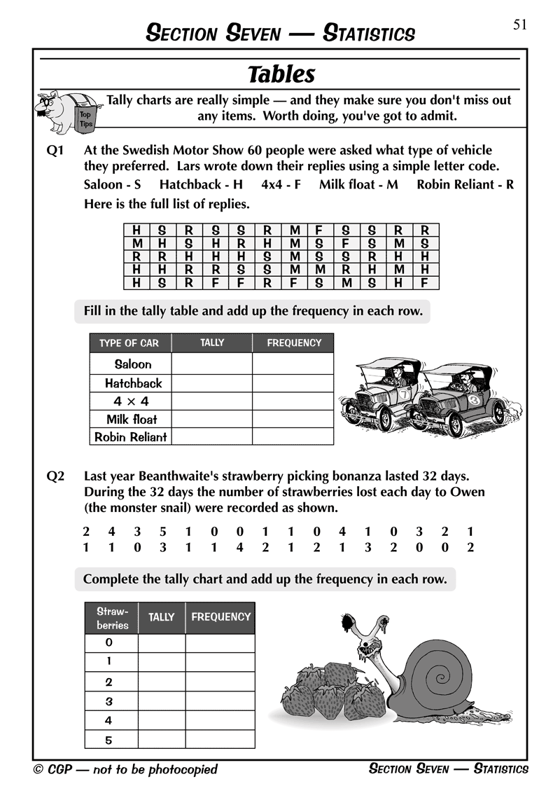
Maths Question Books

Slide 22
Glossary
SPaG: This refers to the spelling, punctuation and grammar tests that form part of the English SATs.
National curriculum tests: This is the official name for the SATs, but the vast majority of people refer to them simply by SATs.
National standard: This is the level that children are expected to reach in their SATs, which is set at 100 for both KS1 and KS2.
Floor standard: If under 65% of a school’s pupils meet the expected standard in reading, writing and maths, and fail to make sufficient progress in all three subjects, the school will be considered below the floor standard.
Expected level/standard: A score of 100 means that your child is working at the expected standard.
Raw score: This is the number of marks your child can get on the tests.
Scaled Score: This is a score that is converted to allow SATs results to be compared year on year. This helps to take into account particularly difficult test years and other factors.
Age-standardised test scores: This is a way for parents to understand how their child did compared with other children who were born in the same month as their own.
League tables: League tables are produced by the Department for Education and they allow primary schools to be ranked by many different measures, including by SATs results.
The DfE: This stands for the Department of Education, and this is the part of government that is tasked with all things education.

Slide 23
ANY QUESTIONS?
?

